Slide 1

IoT Army of 300
Resource Development to enable Our Brightest Minds in Technology
Abdur Rahman
Lecture 2
Introduction to Atmega32
Oct 16, 2017

Slide 2
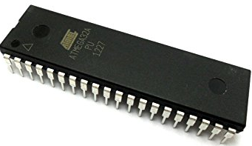
Atmega32 features
High-performance, Low-power Atmel®AVR® 8-bit Microcontroller
Memory
32KB Flash memory: program memory
1KB EEPROM: Data momory
2KB SRAM: Store the value of variable
Register memory:
Write/Erase Cycles: 10,000 Flash/100,000 EEPROM
Operating Voltages : 4.5V - 5.5V
Speed Grades: 0 - 16MHz for ATmega32

Slide 3
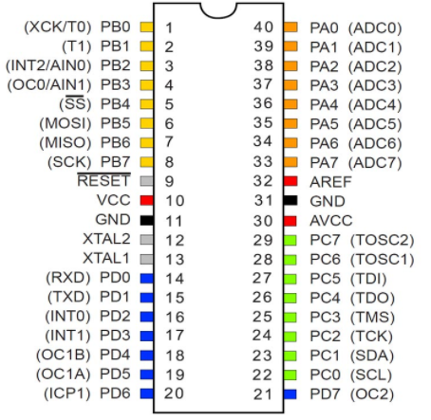
PINOUT
Total pin: 40
4×8=32 I/O pin
4 I/O PORT
PORTA 8 pins
PORTB 8 pins
PORTC 8 pins
PORTD 8 pins
10 bit, 8 channel ADC

Slide 4
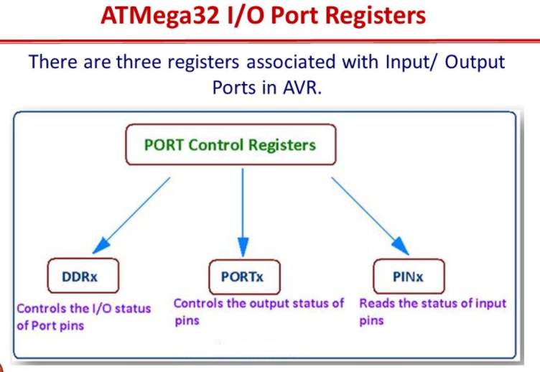

Slide 5
I/O Control Registers
DDRx – Controls the output tristate for port x
DDRx bit = 1 makes the port x an output pin
DDRx bit = 0 makes the port x an input pin
Ex. DDRA = 0b11001100, outputs are bits 7, 6, 3, and 2
PORTx – Control the value driven on port x
Only meaningful if port x is an output
Ex. PORTA = 0b00110011 assigns pin values as shown
PINx – Contains value on port x
Ex. Q = PINC;

Slide 6
Typical Embedded C Program
#include <stdio.h>
main() {
// initialization code
while (1) {
// main code
}
}
#include is a compiler directive to include (concatenate) another file
main is the function where execution starts

Slide 7
C Syntax Basics
Comments: single line //, multiline /* … */
Semicolon used to terminate all statements
# indicates a compiler directive (include, define, etc.)
Brackets { … } group lines of code for execution
Blankspace between lines is not important in C
_{Still need to separate tokens}
int a, b, c;
a = b + c;
int a,b,c;a=b+c;
inta,b,c;a=b+c;
correct
correct
incorrect (inta)

Slide 8
Variables
All variables’ types must be declared
Memory space requirements known statically
Type checking can be performed at compile-time
Numerical Types: int, float, double
Other types: char, void
Type qualifiers: short, long, unsigned, signed, const
Specify alternate sizes, constrain use modes

Slide 9
Variable Declaration
Static allocation vs. Dynamic allocation
Static dedicates fixed space on the stack
int i;
Dynamic (malloc) allocates from the heap at runtime
ptr = malloc(32);
Type sizes depend on the architecture
On x86, int is 32 bits
On ATmega2560, int is 16 bits
char is always 8 bits

Slide 10
Volatile Variables
The value of a volatile variable may change at any time, not just at an explicit assignment
Also, may be read at any time
Compiler optimizations are not applied to volatile variables
for (i=0; i<10000; i++);
An optimizing compiler would delete this loop
i is not used anywhere in the code
i = 1; … i = 1;
If i is not modified in between, the second assignment is removed

Slide 11
Volatile Variables
When can variables be used without an explicit assignment?
1. Memory-mapped peripheral registers
2. Global variables modified by an interrupt service routine
3. Global variables accessed by other processors

Slide 12
Volatile Example
periph is the mapped address of the peripheral status info
*periph is assigned by peripheral directly
.
.
while (*periph != 1); // wait until data transfer
. // is complete
.
Compiled code will move memory contents to a register
Memory will only be moved once because *periph does not change

Slide 13
Base Representation
Base 10 is default
Base can be specified with a prefix before the number
Binary is 0b, Hexadecimal is 0x
Ex. char x = 0b00110011;
char x = 0x33;
Binary is useful to show each bit value
Hex is compact and easy to convert to binary
1 hex digit = 4 binary digits

Slide 14
Types of Statements
Assignment – =
Relational - <, >, ==, !=
Control Flow – if, for, while, do, switch
Arithmetic Operations - +, -, *, /, %
Logical Operations - &&, ||, !
Bitwise Logical Operations - &, |, ^

Slide 15
Logical Operators
These operators accept binary input and produce binary output
&&, ||, !
Non-binary inputs are cast to binary values
int a=1, b=0; c=56; d=-1, res;
res = a && b; // res = 0
res = a || b; // res = 1
res = c && d; // res = 1

Slide 16
Bitwise Operations
Treat the value as an array of bits
Bitwise operations are performed on pairs of corresponding bits
X = 0b0011, Y = 0b0110
Z = X | Y = 0b0111
Z = X & Y = 0b0001
Z = X ^ Y = 0b0101
Z = ~X = 0b1100
Z = X << 1 = 0b0110
Z = x >> 1 = 0b0001

Slide 17
Bit Masks
Need to access a subset of the bits in a variable
Write or read
Masks are bit sequences which identify the important bits with a ‘1’ value
Ex. Set bits 2 and 4 in X, don’t change other bits
X = 01010101, mask = 0010100
X = X | mask
Ex. Clear bits 2 and 4
mask = 11101011
X = X & mask

Slide 18
Bit Assignment Macros
#define SET_BIT(p,n) ((p) |= (1 << (n)))
#define CLR_BIT(p,n) ((p) &= (~(1) << (n)))
1 << (n) and ~(1) << (n) create the mask
Single 1 (0) shifted n times
Macro doesn’t require memory access (on stack)

Slide 19
Header Files
Files included at the top of a code file
Traditionally named with .h suffix
Include information to be shared between files
Function prototypes
externs of global variables
Global #defines
Needed to refer to libraries

Slide 20
Compilers/IDE for AVR
WinAVR free
Atmel Studio free
Micro c pro for AVR paid
Simulator:
proteus 8.1

Slide 21
Local IP: 192.168.2.133
Public IP: 182.48.84.180

Slide 22
